Slide 1

Health monitoring systems
Presented to : Mr. Ankit Verma
Presented by : Daljeet Singh
Shristi Jain
Km Gouri

Slide 2
Contents
Introduction
Why Health Monitoring?
Brief Discussion on Related Work
Comparison of Existing Works
Conclusion

Slide 3
Introduction
The consumers and healthcare service providers using smart phones are growing exponentially throughout last decade.
The adoption of this technology is rapid; two-thirds of physicians and 42% of the public used smartphones as of late 2009. [1]
As of February 2010, there were nearly 6,000 such apps within the Apple App Store.
Of these, 73% were intended for use by consumer or patient end-users, while 27% were targeted to healthcare professionals.

Slide 4

Why Health Monitoring?
Based on World Health Organization’s Statistics (WHO) and other sources, chronicle diseases and psychological pressures are behind the death of 80% of elderly people (e.g. in Algeria).
The greater part of elderly suffer from various chronic diseases.
We plan to elucidate on how recent advancement in wireless communication and smartphone technology have empowered tremendous improvement in health monitoring services.
Provide behavioral feedback about someone’s health in order to prevent diseases.

Slide 5

Initial Work
Vital signs are the most basic functions that can be measured from a person.
Provide health monitoring at home, which is particularly useful for patients, who have to live alone.
Focused on the automatic and unobtrusive measurement of biomedical signals and activities of patients.
Ubiquitous health monitoring is an important precursor for analysis and diagnosis, as it allows biomedical signals to be measured without the individual’s awareness.

Slide 6
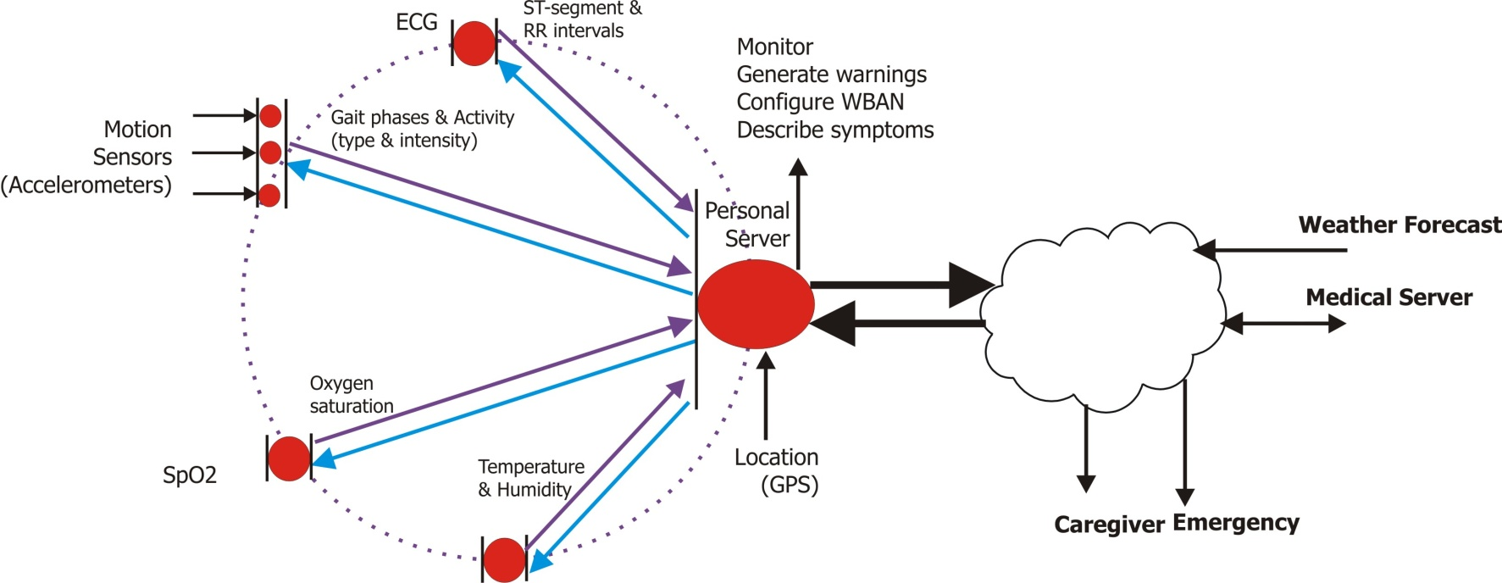
Data flow in an WBAN
Sensor level
Personal Server Level
Medical Service Level

Slide 7
What Is The Current Face Of Health Monitoring?
Health monitoring is no longer for the physicians or hospitals.
It is no longer for people with chronic diseases.
Monitoring for all ages.
People showing interest in self diagnosis before spending on a doctor.
Cost effective.
Sophisticated devices.
Better networking stack.

Slide 8
Conclusion
Through this presentation we have given a overview of the various works done in mobile health and some differences between them.
There is a high penetration in the health sector with the advent of new range of smart phones and better customizable OS.
Mobile health monitoring system is here to stay for the future.
Mobile health is not just monitoring, it will and should grow as a user community to help each other and serve efficiently during emergency situations.

